Slide 1
HR Manager System
Manage the employees in my company
Nikolay Dimitrov

Slide 2
The Problem
Task: As an HR manager, I want to be able to manage the employees in my company.
The hierarchy in the company includes the following roles:
Trainee
Junior
Intermediate
Senior
Team leader
Project manager
Delivery director
CEO
Each employee must have information about Name, his position, salary, workplace-City, email, phone, Project name (without project) and his manager.
Trainee, Junior, Intermediate and Senior employees are part of team managed by a Team lead. One project manager can manage multiple teams. Delivery director is on top of multiple project managers. CEO is the head of the entire company.
I must be able to add a new employee, see and edit the existing ones.
I need to be able to choose Trainee, Junior, Intermediate, Senior or Team lead and see in which team they belongs together with information who is their Lead, Project Manager, Delivery director, CEO.
I need to be able to move employees to different teams and delivery verticals.

Slide 3
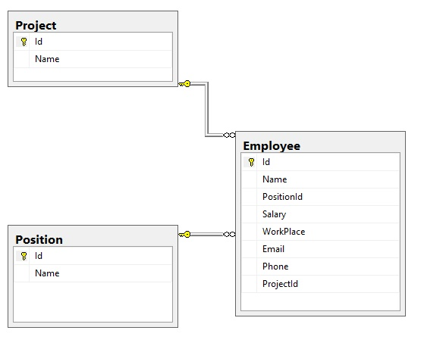
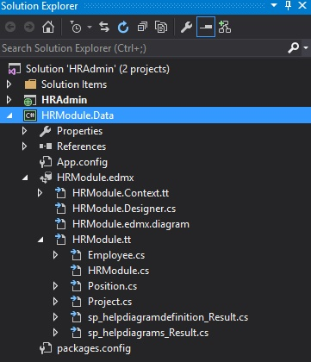
Database- diagram and relation
Employee table – main information about the employee,
relation one to one to Positon table, relation one to
many to Project table
Project table
Position table
Entity Framework Database First-
Allows you to reverse
engineer a model
from an existing database.

Slide 4
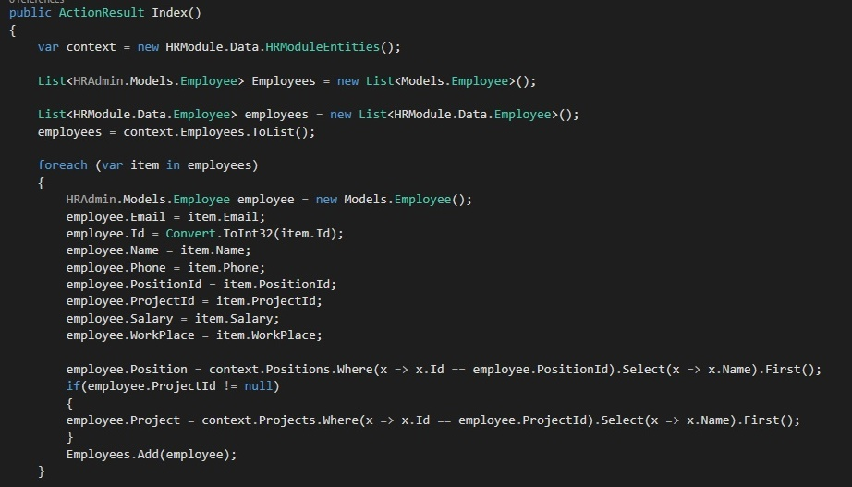
ControllerEmployee Action Index
We create two instances
for classes Employee - one
from EF and the other one
from our model which is
used by View
continued on next slide

Slide 5
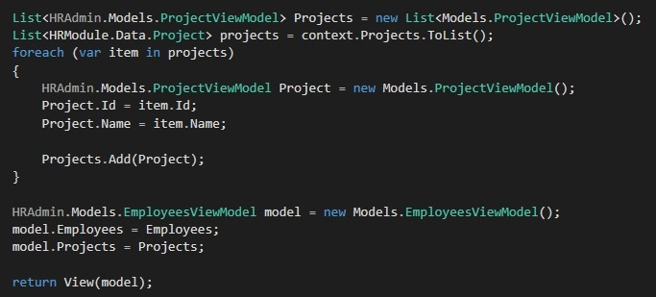
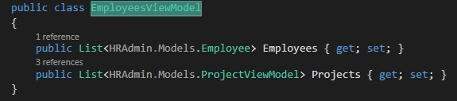
ControllerEmployee Action Index
We create two instances
for classes Projects - one
from EF and the other one
from our model which is
used by View.
Variable model from type
EmployeeViewModel
contains Two Lists from type
Employee and ProjectViewModel

Slide 6
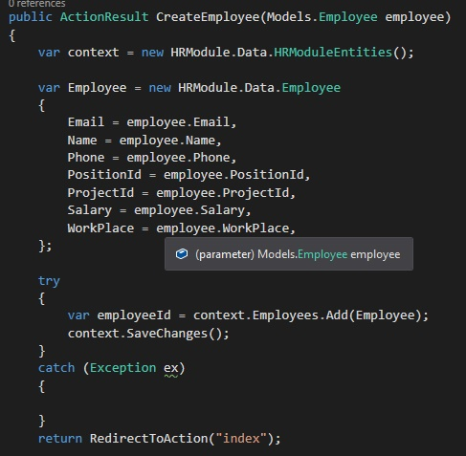
ControllerEmployee Action CreateEmployee
Record the input data from
the user in the database
different result type called
RedirectToAction “Index”

Slide 7
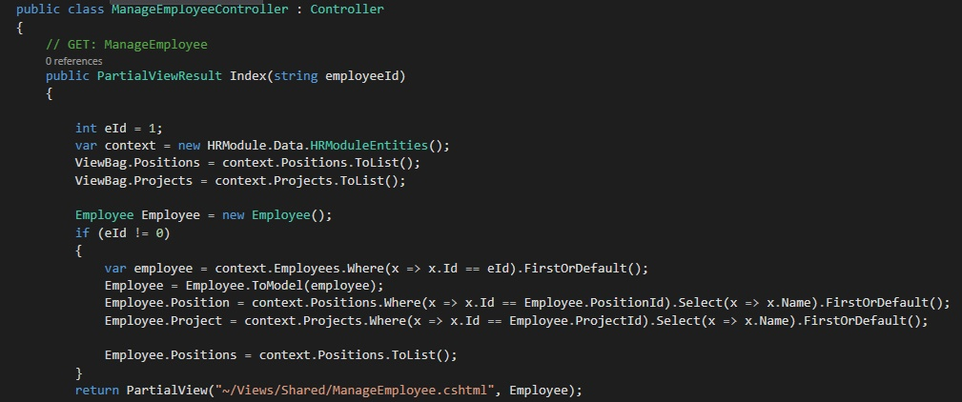
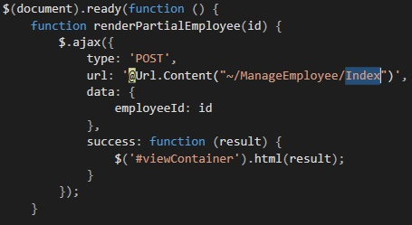
ManageEmployeeController PartialViewResult Index
ViewBag in which we
dynamically enter each one
of eight possible positions of
a given employee and their
project.
Return PartialView in order
not to render all the HTML
page stuff but only collapse panel
An ajax function for intercepting
event in Manage panel

Slide 8
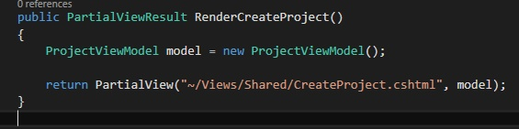
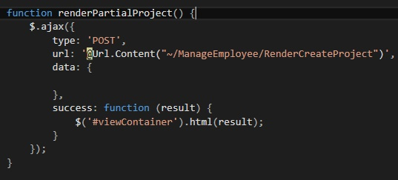
ManageEmployeeControler PartialView RenderCreateProject
Creating an instance of ModelProject.
Again in order not to reload the whole page
when we want to create a new project
we return PartialView
An ajax function for intercepting
event in Creating project panel

Slide 9
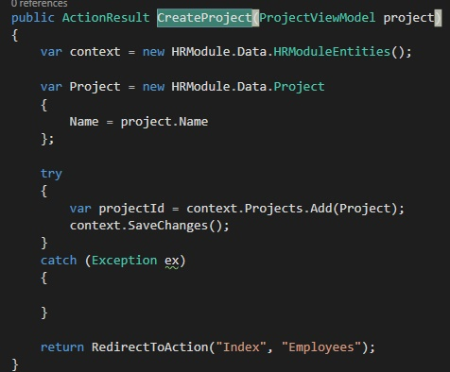
ManageEmployeeController PartialView CreateProject
Creating instance of the class Project by recording
the value of our model Project.
Redirecting to Action Index of ControllerEmployee

Slide 10
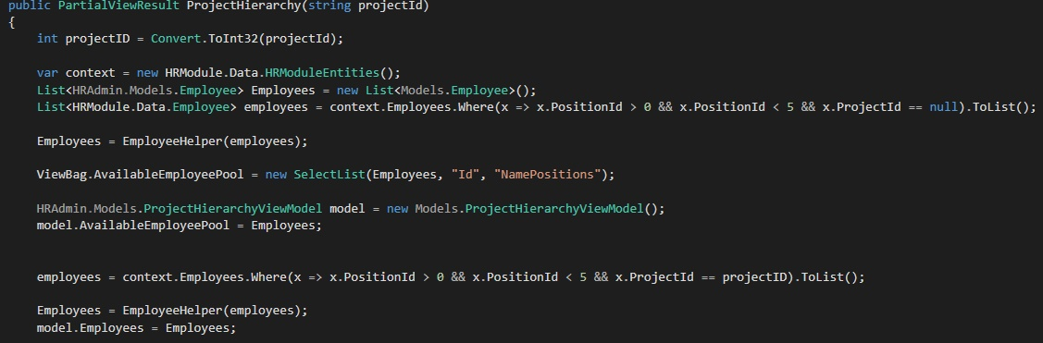
ProjectControll PartialView ProjectHierarchy
Creating of instance
of model Employee
from EF and model
employee.
A ViewBag for
adding dynamically the
employees who don’t
have a project
continued on next slide

Slide 11
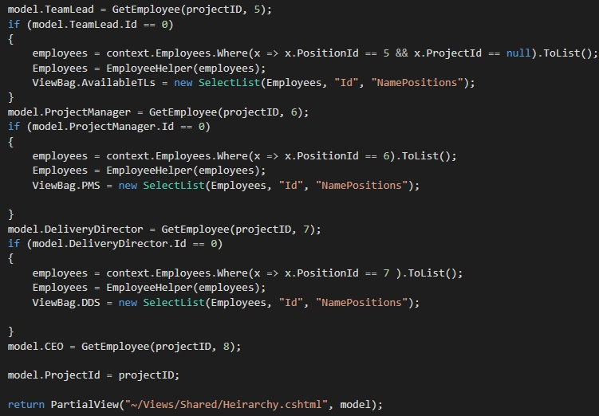
ProjectControll PartialView ProjectHierarchy
Some “if” statements witch check
whatever the project has got a TL,
PM or DD. If it doesn`t it creates a new
SelectList. The list is put dynamically
into ViewBag
continued on next slide

Slide 12
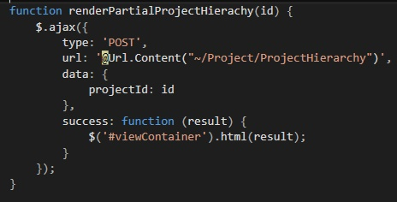
ProjectControll PartialView ProjectHierarchy
An ajax function for intercepting
event in creating a hierarchy panel

Slide 13
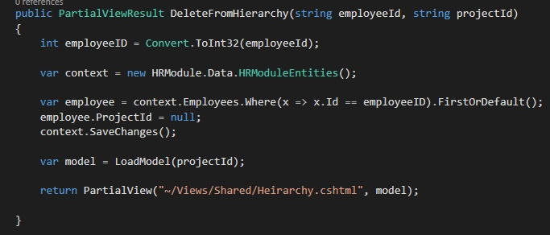
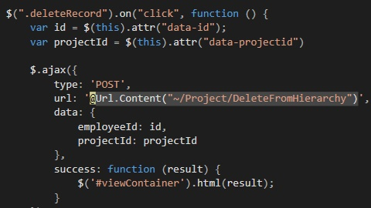
ProjectControll PartialView DeleteFromHierarchy
This method is for deleting the
Employee from project and return
to the pool
Java Script function which is
situated in the Hierarchy View and it
uses ajax

Slide 14
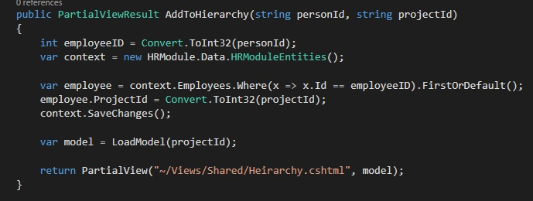
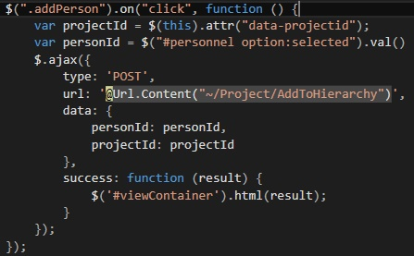
ProjectControll PartialView AddFromHierarchy
This method is for adding the
Employee to the project and return
Ajax query add dynamically Employee

Slide 15
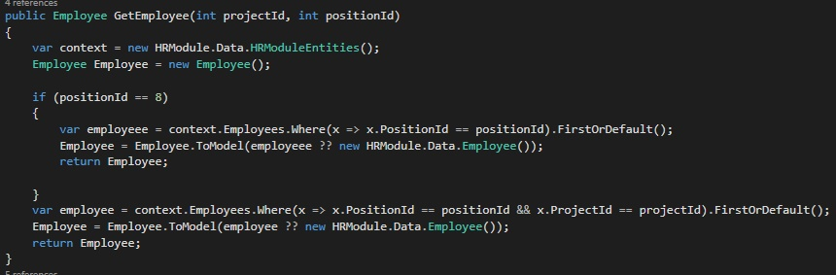
Method GetEmployee
Takes the specific employee
from the database by his
position Id

Slide 16
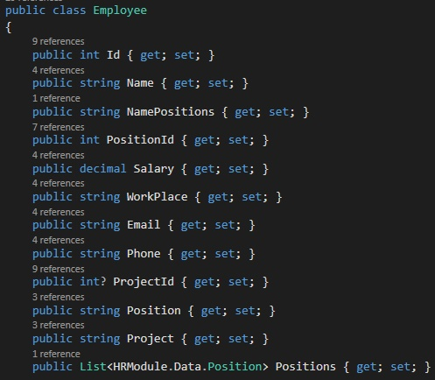
Employee Model
Our model Employee

Slide 17
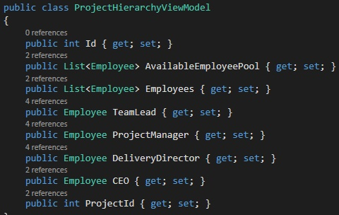
Model ProjectHierarchy
Model for our hierarchy of the company

Slide 18
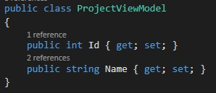
Model Project
Model for our project in the company

Slide 19
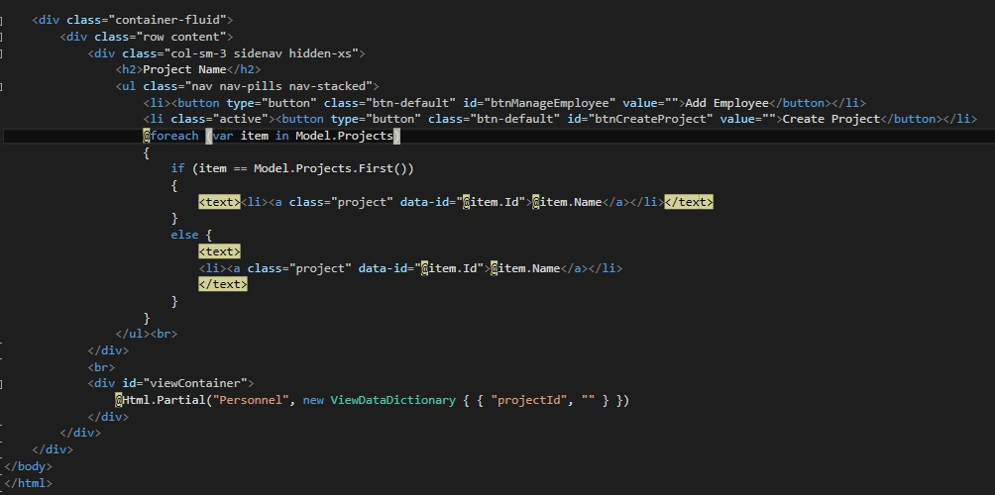
View Main Page
Our HTML for the
main page
We are using
razor in order to display
the information from
the loaded models

Slide 20
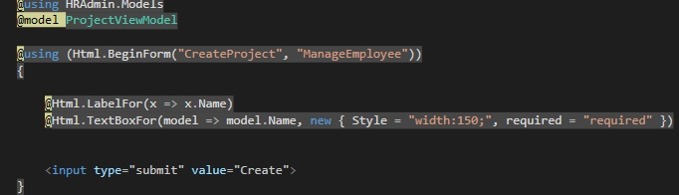
Creating Project View
Simple HTML form for creating
projects.

Slide 21
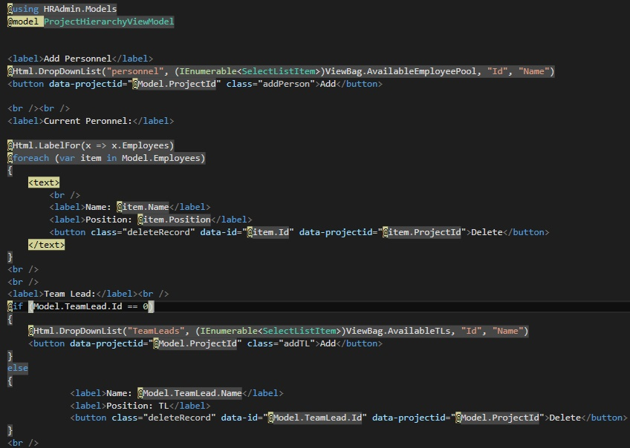
Hierarchy View
Hierarchy page
continued on next slide

Slide 22
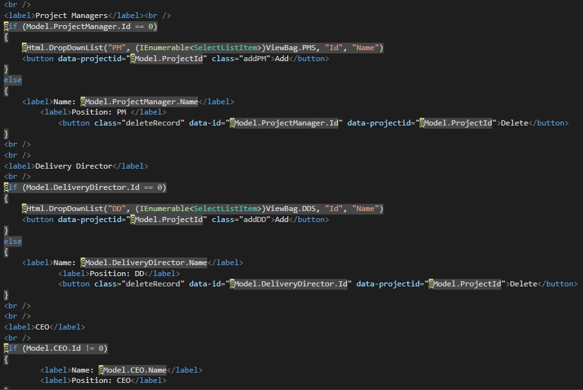
Hierarchy View
Hierarchy page

Slide 23
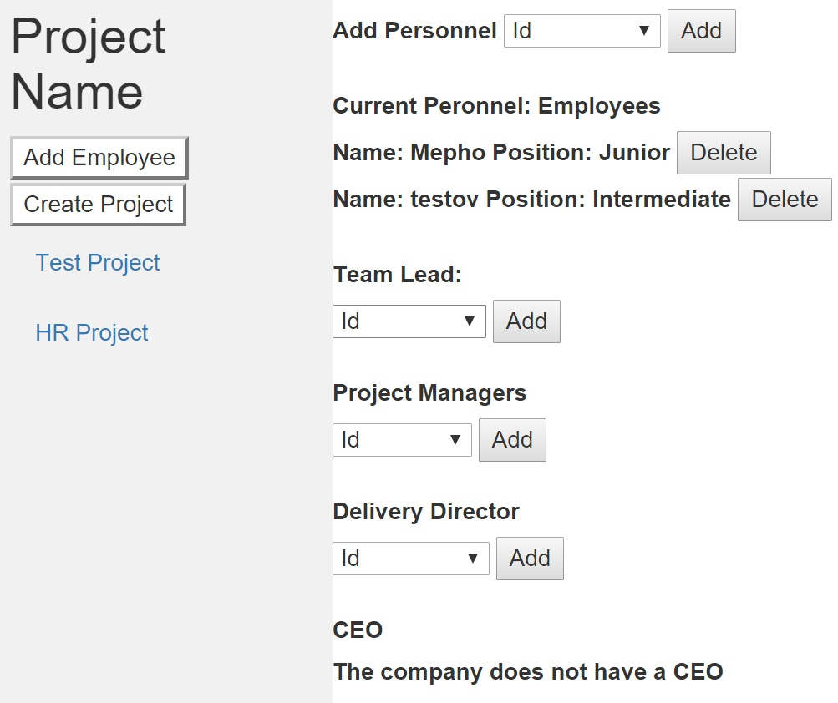
Live Demo
HR System
Demonstration

Slide 24
Thank you and if you have any questions, please don’t hesitate to ask

